Slide 1
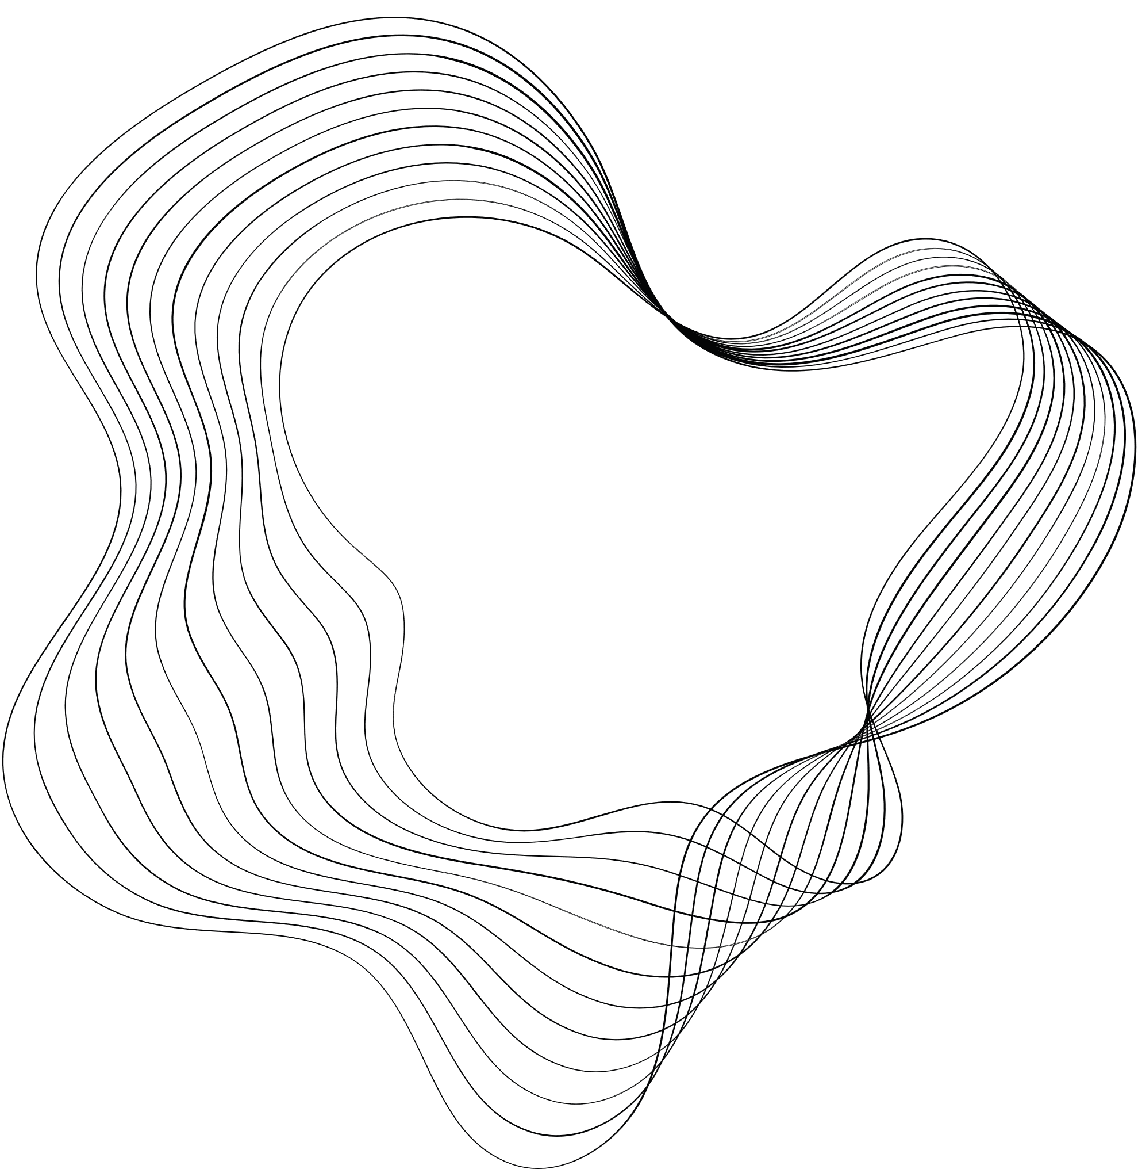

INTRODUCTION TO ROBOTICS
REALSENSE BASED SYSTEM FOR TRACKING HAND POSE
Dhruv Gupta(B20MT019)
NileshGupta(B20ME050)

Slide 2
INTRODUCTION
The aim of this project is to create a virtual touch screen with the help of intel realsense depth camera to design an interactive game that help students to learn alphabets.
The existing solution for this problem is based on 2D laser sensor. It uses the input from the 2D sensor to get the coordinates of hand in space and convert the projected screen into a responsive touch screen.
Using a 3D sensor may provide a good accuracy and less time consuming and effective calibration. With the help of 3D sensor, we had also designed it in a way that person with a disability can also use it, which otherwise may not possible.

Slide 3
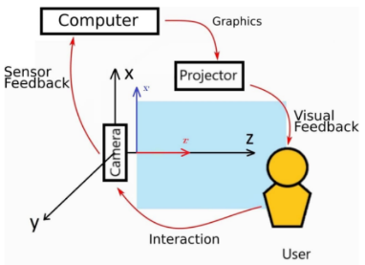
Proposed Solution
For creating an interactive projected screen, we had used
hand detection technique (based on media pipe) on the
input video feed from the sensor identified the projected
screen in the space integrated these with a game that will
help kids to learn the alphabet.
We used an auto-calibration technique based on image processing that does not require human intervention.
The developed game is simple. The user had to choose the correct alphabet from the six options.
The human hand is an incredible gift enabling us to interact with the world. However, for some individuals, hand mobility may be impaired due to disabilities. This is where we thought to modify the project and present a solution in this project

Slide 4
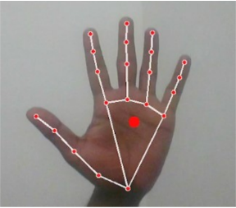
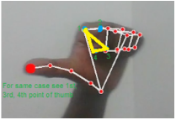
Hand Detection
Using a media pipe library, an active hand detection method was developed that detects the hand in the continuous video feed from the depth camera. The media pipe library uses 21 landmark points to detect the hand.
When all the fingers are open, then we use an average of the coordinates of the landmarks 0, 5, 9, 13, and 17 taken and the landmark of the tip of the finger if any single finger is open, the finger is open.
To achieve this, a system is developed to identify when and which fingers are closed and open.

Slide 5
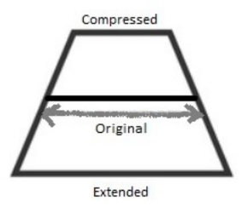
Camera Calibration
The major challenge now is to identify and distinguish the area of the projected screen. The projected screen may have some distortions.
For that an automatic calibration technique was developed based on color recognition and image processing.
Red, green and blue color are projected on the screen one by one and their images were taken and processed.
The major color is identified using openCV and its coordinates were noted, its repeated for all three color for accuracy. This gives us the pixel coordinates of the 4 corner of the quadrilateral.

Slide 6

Integration of camera with game
Now the depth data of each point of the identified region is stored which is further used to give us touch information. The depth data of the hand or finger is continuously taken by the sensor and is compared to the depth data stored for that pixel coordinates.
If the depth data of both matches then a touch is considered and game can react accordingly.
After this the calibration is done and game can be played. In game the instructions are announced for the user to which alphabet to use and it announces correct or wrong selection acordingly.

Slide 7
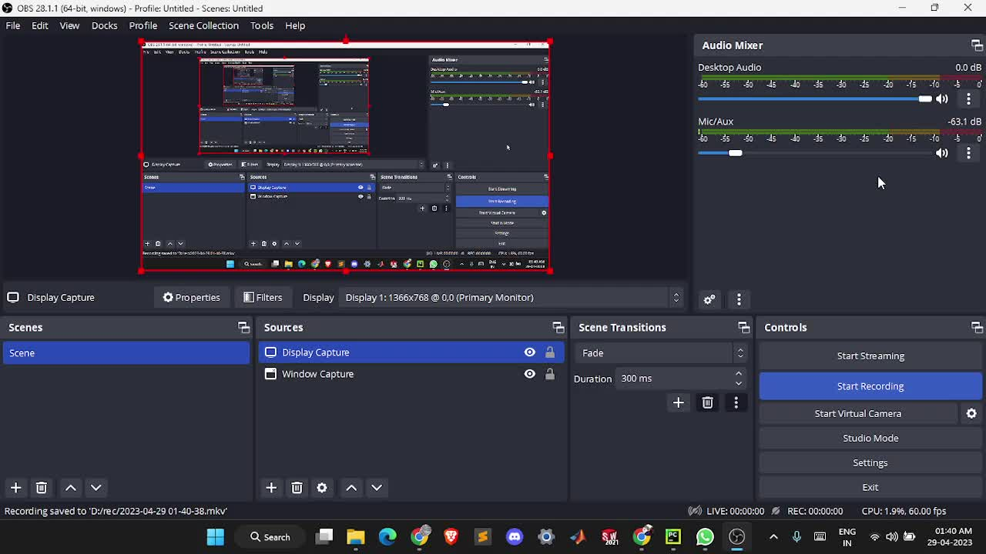
Video Demonstration

Slide 8
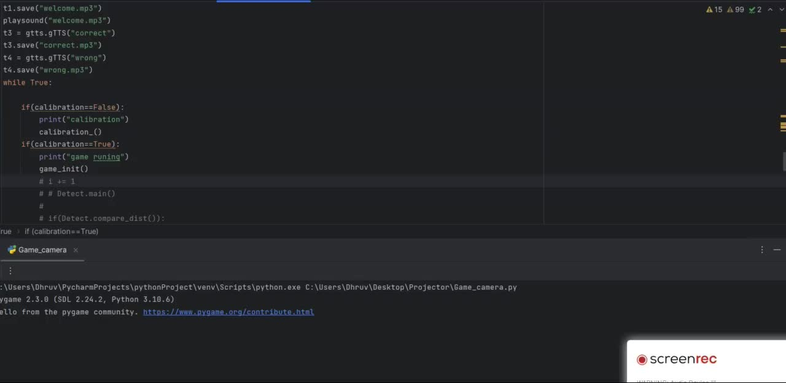
Calibration

Slide 9
Hand detection in threshold value
The threshold value set for our hand movement will be considered that we are using the screen is 10cm. We can do it simply by recording 1st distance of the screen from the Realsense camera and store for all pixels. Now compare your hand pixel distance with your screen pixel distance.
If it < 10cm:
detected

Slide 10

Detection

Slide 11
Thank You

